Slide 1
Introduction to Complex Networks
ASU 2016 Spring SES 494/598: Fundamentals of Complexity
Hyunju Kim

Slide 2
What is a network?

Slide 3
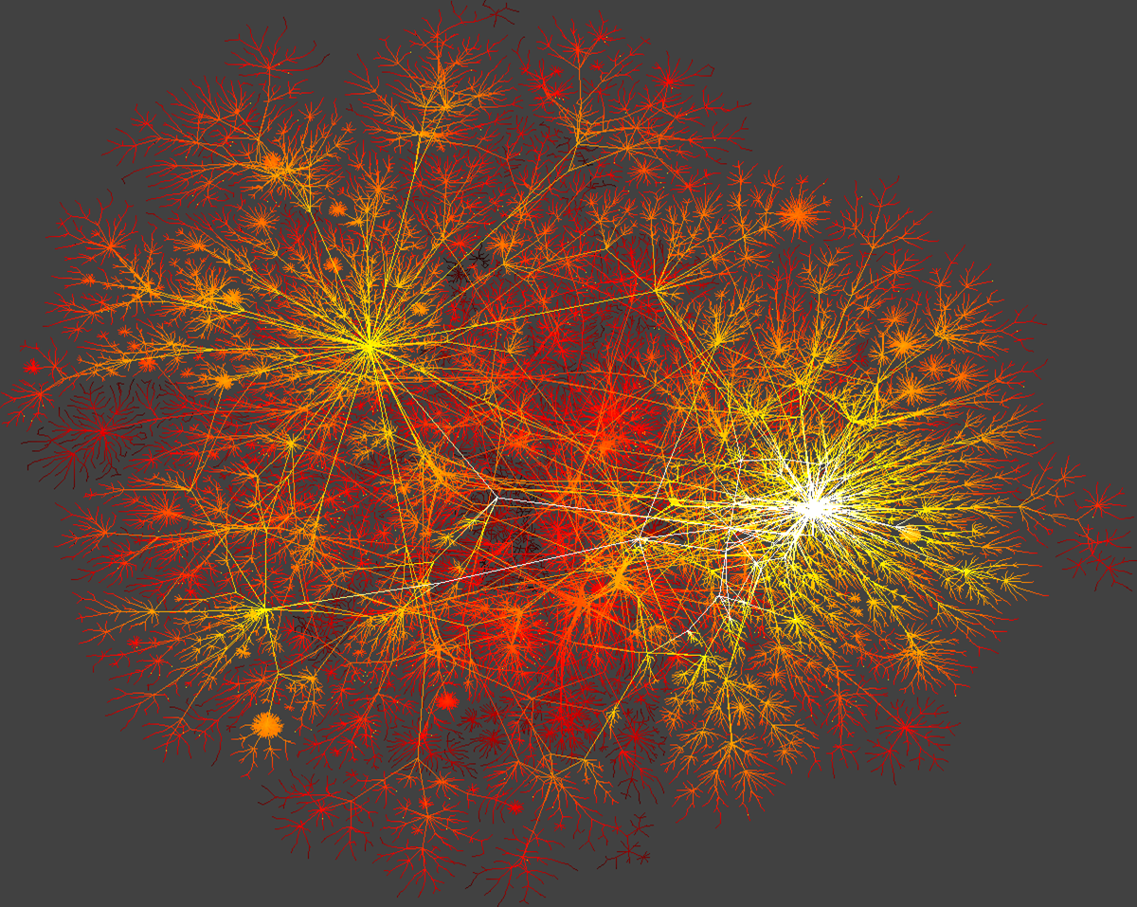
Skitter data depicting a macroscopic snapshot of Internet connectivity, with selected backbone ISPs (Internet Service Provider) colored by K. C. Claffy

Slide 4
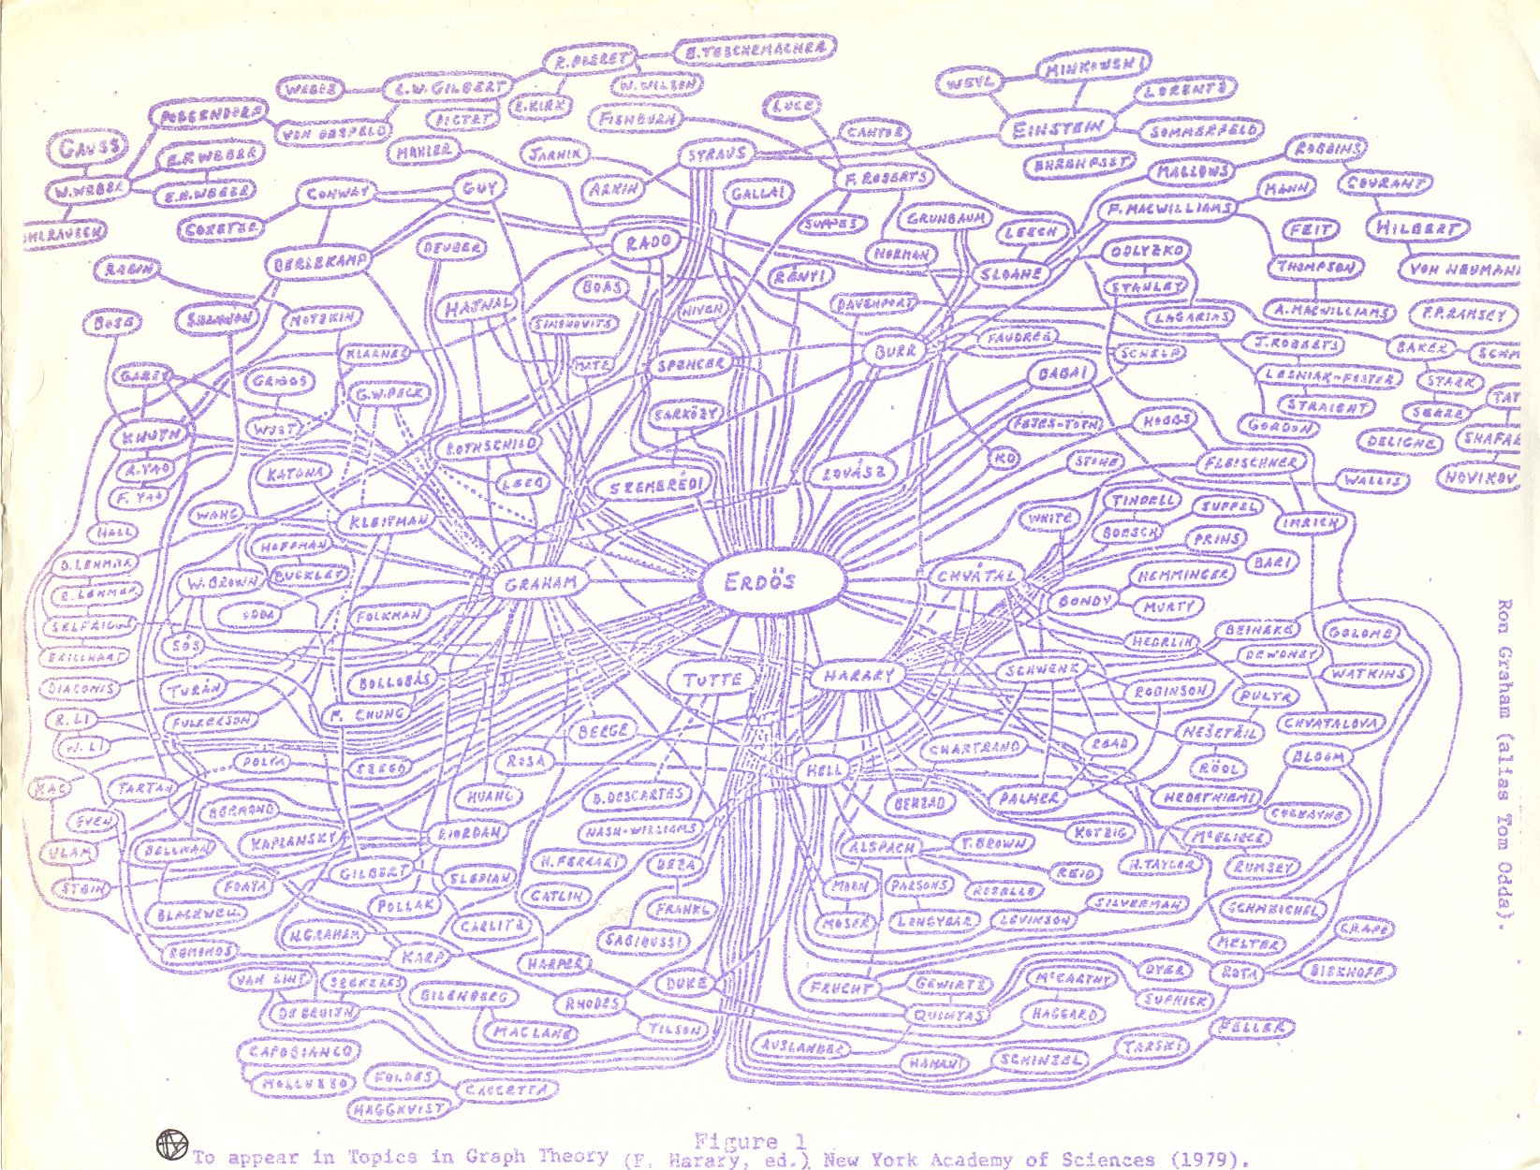

Slide 5
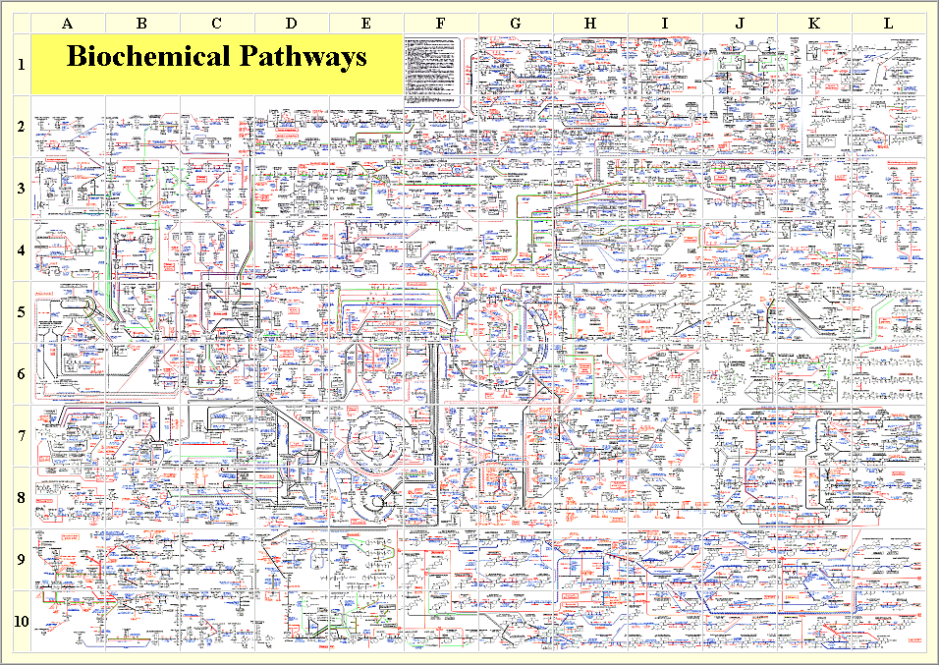
collaboration

Slide 6
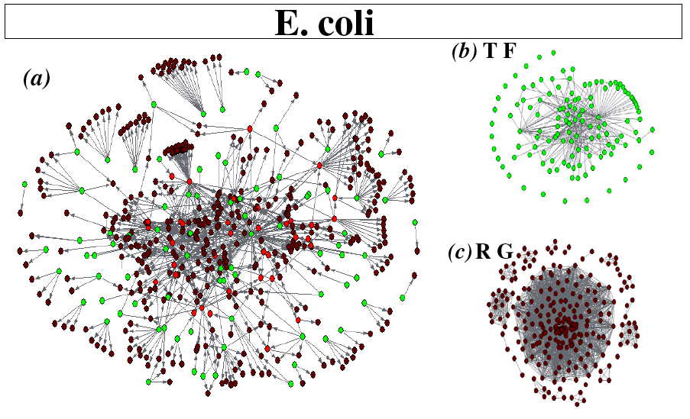
L. Guzman-Vargas and M. Santillan, BMC Sys. Biol. 2:13 (2008)
collaboration

Slide 7
Definition of networks
Network (Graph): a mathematical model that encodes pairwise relationships (edges or links) amongst entities (vertices or nodes)
0
1
4
3
2

Slide 8
Definition of networks
Edge list
Source-Node Target-Node Weight
1 2 2.0 1 3 1.0
2 1 2.0
2 3 1.0
3 2 1.0
3 4 2.5
1.0
1
0.0
4
3
0.0
2
2.0
Node list
Node Attribute
1 1.0
2 2.0
3 0.0
4 0.0

Slide 9
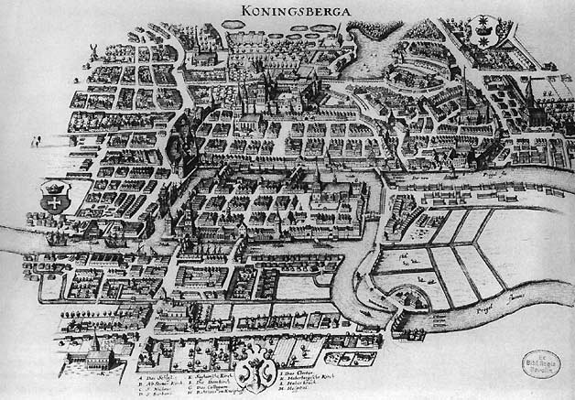

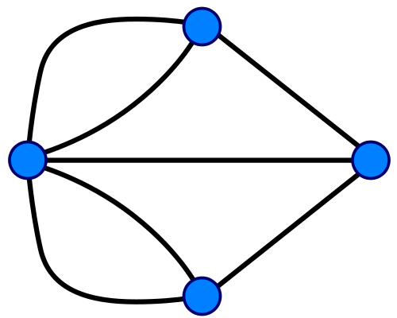

Seven Bridges of Königsberg : Leonhard Euler - 1735

Slide 10
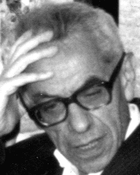
Random graph model (Erdős–Rényi model) - 1959
N = 12, P = 1/6

Slide 11
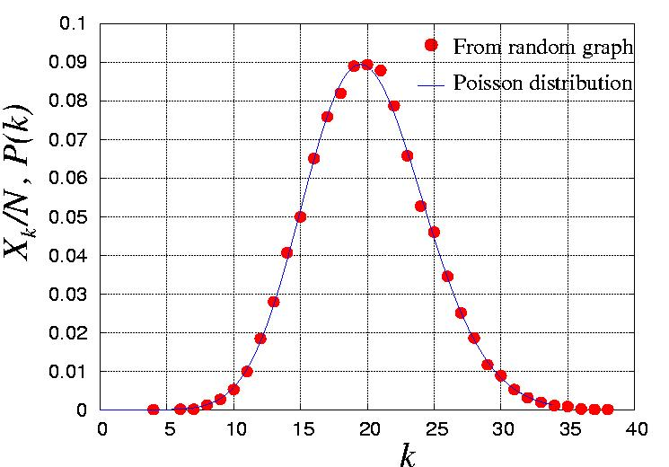
Random graph model (Erdős–Rényi model) - 1959
Poisson distribution
N = 8,
P = 0.3
7
1
6
5
8
4
λ=<k>
2
3
d_{i} - degree of node i.
Degree sequence
d₁ =5, d₂ =2, d₃ =1, d₄ =2, d₅ =3, d₆ =2, d₇ =2, d₈ =3

Slide 12
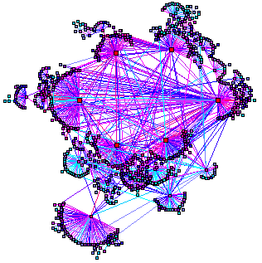
World Wide Web
WWW documents
URL links
Over 3 billion documents
P(k) ~ k^{-γ}
Barabási & Albert, Science 286, 509 (1999)

Slide 13
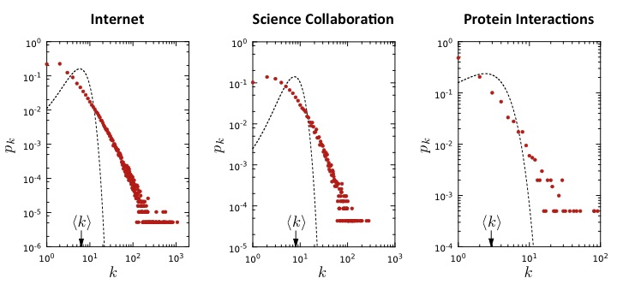

Slide 14
The Barabási-Albert model - 1999
(1) Networks continuously expand by the addition of new nodes
GROWTH:
add a new node with m links
WWW : addition of new documents
PREFERENTIAL ATTACHMENT:
the probability that a node connects to a node with k links is proportional to k.
(2) New nodes prefer to link to highly connected nodes.
WWW : linking to well known sites
P(k) ~k⁻³
Barabási & Albert, Science 286, 509 (1999)
Network Science: Evolving Network Models

Slide 15
(Shortest) Path length & Diameter

Slide 16
Six Degree Separation - Small World Property
Milgram’s experiment - 1967
Notes:
IF YOU KNOW THE TARGET PERSON ON A PERSONAL BASIS, MAIL THIS FOLDER DIRECTLY TO HIM (HER). IF NOT, MAIL THIS FOLDER (POST CARDS AND ALL) TO A PERSONAL ACQUAINTANCE WHO IS MORE LIKELY THAN YOU TO KNOW THE TARGET PERSON

Slide 17
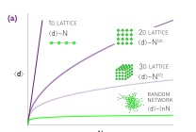
How small are the real world networks?
N

Slide 18
Clustering coefficient

Slide 19
Clustering coefficient of real world networks
CC for Random Networks

Slide 20
Watts and Strogatz Model -1998

Slide 21
Watts and Strogatz Model -1998

Slide 22
Assortativity

Slide 23
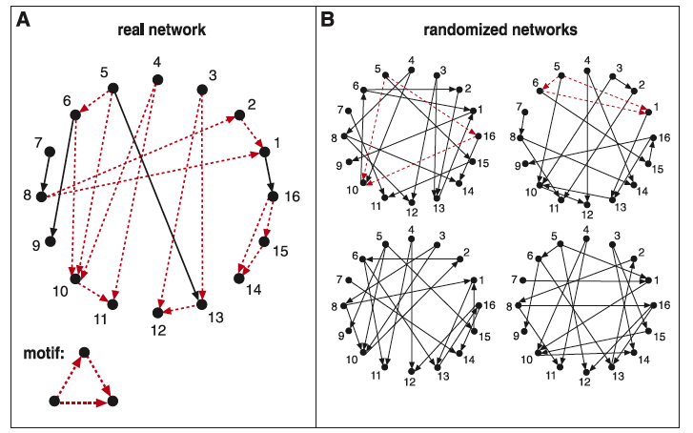
Motifs
Motif: a small graph (recurring, significant patterns)
R. Milo, S. Shen-Orr, S. Itzkovitz, N. Kashtan, D. Chklovskii, and U. Alon. Science, 298:824–827, 2002.

Slide 24
What are we going to do with networks?

Slide 25
General Outline for Projects
Boolean network modeling for various systems
Time evolution of the Boolean networks
Transition mapping between network state in attractor landscape
Information dynamics for the Boolean networks
Information processing: Transfer Entropy (TE)
Information storage: Active Information (AI)

Slide 26
Boolean Biological Network

Slide 27
b
c
a
i
Node i = Protein i
S_{i} : State of node i
If protein i is present,
S_{i} = 1
i
If protein i is absent,
S_{i} = 0
i

Slide 28
b
c
a
Edges = Biochemical interactions between two proteins
a_{ij} : Weight of edge(i, j)
If i is activating j ,
a_{ij} = 1
i
j
If i is inhibiting j ,
a_{ij} = -1
i
j
If i doesn’t affect j ,
a_{ij} = 0
no link from i to j
Notes:
activating interaction (green link) from node j to node i, aij(t) = 21 for an inhibiting

Slide 29
Updating rule for the Boolean network
(a, b, c) = (0,1,0)
(a, b, c) = (1,0,0)
b
b
c
a
c
a
Notes:
Node a gets positive input from node b and nothing from c or a itself. Therefore the total input from previous step is positive and a becomes 1 at the next time step. On the other hand, b gets negative input from itself and hence its state becomes 0 at the next step.

Slide 30
Transition mapping between network states

Slide 31
Applying the updating rule for all possible network state
(0,0,0)
(0,0,0)
State Transition in Network State Space
(0,0,1)
(0,1,0)
(1,1,0)
(0,1,0)
(1,0,0)
(1,1,1)
(0,0,0)
(0,1,1)
(0,1,0)
attractors
(1,0,1)
(0,1,1)
(1,0,0)
(0,1,1)
(1,1,0)
(1,1,1)
(0,1,0)
(1,0,0)
(1,0,1)
(0,1,1)
(0,0,1)
(1,1,1)
(0,1,1)

Slide 32
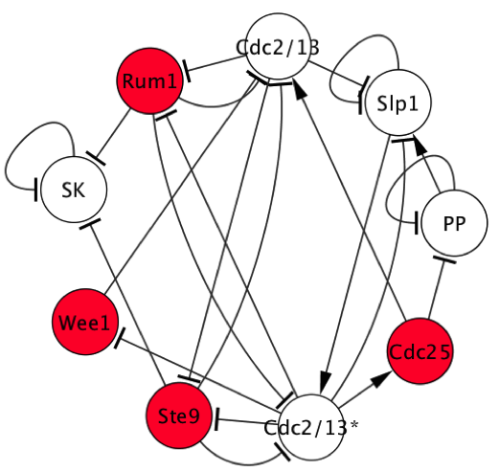
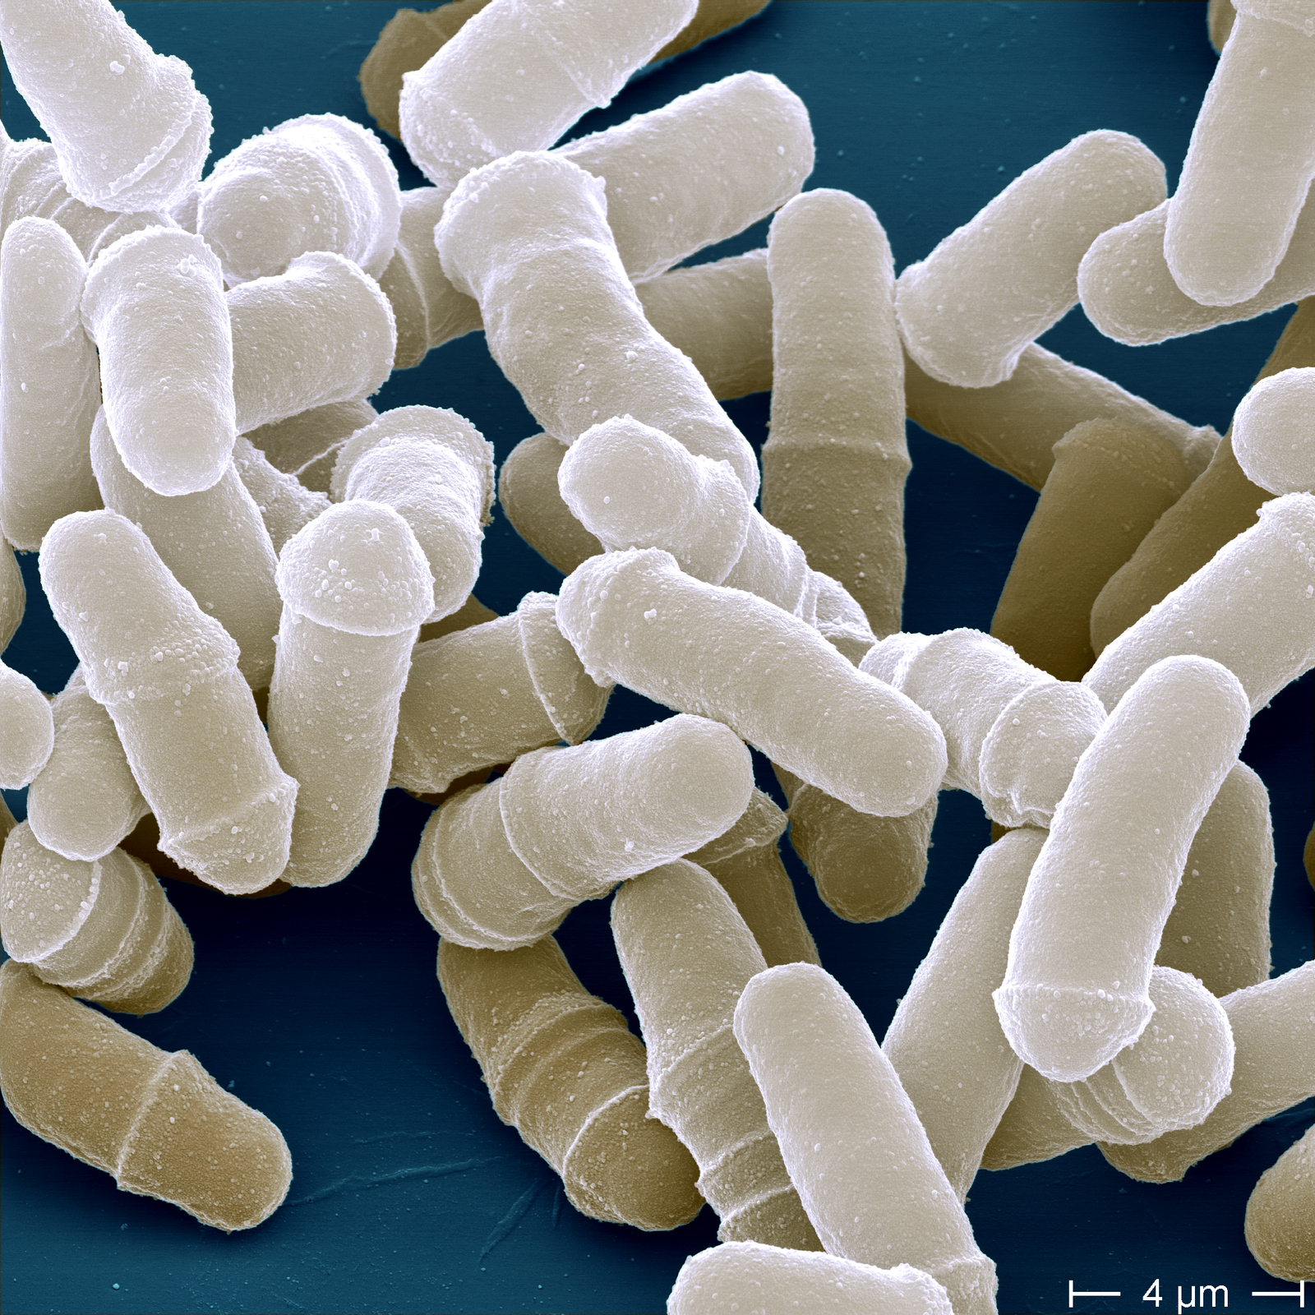
Fission yeast (S. Pombe) cell-cycle network
(Present)
(Absent)

Slide 33
Fission network simulates the cell-cycle process (G₁ ➔ S ➔ G₂ ➔ M)
Time | SK | C13 | Ste9 | Rum | Slp1 | C13* | Wee | C25 | PP
1
2
3
4
5
6
7
8
9
G₁
G₁/S
G₂
G₂
G₂/M
G₂/M
M
M
G₁
“Boolean Network Model Predicts Cell Cycle Sequence of Fission Yeast” Maria I. Davidich and Stefan Bornholdt, PloS ONE (2008)

Slide 34
Robustness of the model: G₁ is the dominant attractor of the network dynamics
G₁
G₁/S
G₂
G₂
G₂/M
G₂/M
M
M
G₁
“Boolean Network Model Predicts Cell Cycle Sequence of Fission Yeast” Maria I. Davidich and Stefan Bornholdt, PloS ONE (2008)

Slide 35
Regulation of Control Kernel drives all network states to the primary attractor
Ste9 | Rum1 | Wee1 | Cdc25

Slide 36
Regulation of Control Kernel drives all network states to the primary attractor
Ste9 | Rum1 | Wee1 | Cdc25

Slide 37
Time Series Data of Boolean Network

Slide 38
Running Boolean model with initial condition (a, b, c ) = (1, 1, 1).
Time Step | a | b | c
1 | 1 | 1 | 1
t = 1
b
c
a

Slide 39
Running Boolean model with initial condition (a, b, c ) = (1, 1, 1).
Time Step | a | b | c
1 | 1 | 1 | 1
2 | 0 | 1 | 1
t = 2
b
c
a

Slide 40
Running Boolean model with initial condition (a, b, c ) = (1, 1, 1).
Time Step | a | b | c
1 | 1 | 1 | 1
2 | 0 | 1 | 1
3 | 0 | 1 | 0
t = 3
b
c
a

Slide 41
Running Boolean model with initial condition (a, b, c ) = (1, 1, 1).
Time Step | a | b | c
1 | 1 | 1 | 1
2 | 0 | 1 | 1
3 | 0 | 1 | 0
4 | 1 | 0 | 0
t = 4
b
c
a

Slide 42
Running Boolean model with initial condition (a, b, c ) = (1, 1, 1).
Time Step | a | b | c
1 | 1 | 1 | 1
2 | 0 | 1 | 1
3 | 0 | 1 | 0
4 | 1 | 0 | 0
5 | 0 | 1 | 1
t = 5
b
c
a

Slide 43
Running Boolean model with initial condition (a, b, c ) = (1, 1, 1).
Time Step | a | b | c
1 | 1 | 1 | 1
2 | 0 | 1 | 1
3 | 0 | 1 | 0
4 | 1 | 0 | 0
5 | 0 | 1 | 1
6 | 0 | 1 | 0
t = 6
b
c
a

Slide 44
Running Boolean model with initial condition (a, b, c ) = (1, 1, 1).
Time Step | a | b | c
1 | 1 | 1 | 1
2 | 0 | 1 | 1
3 | 0 | 1 | 0
4 | 1 | 0 | 0
5 | 0 | 1 | 1
6 | 0 | 1 | 0
7 | 1 | 0 | 0
t = 7
b
c
a

Slide 45
Running Boolean model with initial condition (a, b, c ) = (1, 1, 1).
Time Step | a | b | c
1 | 1 | 1 | 1
2 | 0 | 1 | 1
3 | 0 | 1 | 0
4 | 1 | 0 | 0
5 | 0 | 1 | 1
6 | 0 | 1 | 0
7 | 1 | 0 | 0
8 | 0 | 1 | 1
t = 8
b
c
a

Slide 46
Running Boolean model with initial condition (a, b, c ) = (1, 1, 1).
Time Step | a | b | c
1 | 1 | 1 | 1
2 | 0 | 1 | 1
3 | 0 | 1 | 0
4 | 1 | 0 | 0
5 | 0 | 1 | 1
6 | 0 | 1 | 0
7 | 1 | 0 | 0
8 | 0 | 1 | 1
9 | 0 | 1 | 0
t = 9
b
c
a

Slide 47
Running Boolean model with initial condition (a, b, c ) = (1, 1, 1).
Time Step | a | b | c
1 | 1 | 1 | 1
2 | 0 | 1 | 1
3 | 0 | 1 | 0
4 | 1 | 0 | 0
5 | 0 | 1 | 1
6 | 0 | 1 | 0
7 | 1 | 0 | 0
8 | 0 | 1 | 1
9 | 0 | 1 | 0
10 | 1 | 0 | 0
t = 10
b
c
a

Slide 48
Information Dynamics

Slide 49
Information Storage
The information storage of an agent in the system is the
amount of information in its past that is relevant to predicting its future.
It is formulated in the active information
Information Transfer
The information transfer between a source and a destination agent is defined as the information provided by the source about the destination’s next state that was not contained in the past of the destination.
It is formulated in the transfer entropy

Slide 50
Time Series Data
Time Step | a | b | c
1 | 1 | 1 | 1
2 | 0 | 1 | 1
3 | 0 | 1 | 0
4 | 1 | 0 | 0
5 | 0 | 1 | 1
6 | 0 | 1 | 0
7 | 1 | 0 | 0
8 | 0 | 1 | 1
9 | 0 | 1 | 0
10 | 1 | 0 | 0
A sequence of time ordered observations of some system.
For example, the Boolean network generates the set of states of nodes in the order of time.
To measure information dynamics on the time series data, one needs to compute the distribution for each pattern to occur in the data.

Slide 51
: k history state of X
Time Step | a | b | c
1 | 1 | 1 | 1
2 | 0 | 1 | 1
3 | 0 | 1 | 0
4 | 1 | 0 | 0
5 | 0 | 1 | 1
6 | 0 | 1 | 0
7 | 1 | 0 | 0
8 | 0 | 1 | 1
9 | 0 | 1 | 0
10 | 1 | 0 | 0
The states of node X from k consecutive previous steps from the current step n
: future state of X
The state of node X at the next step for the current step n
For example,

Slide 52
With a given N time series data,
Time Step | a | b | c
1 | 1 | 1 | 1
2 | 0 | 1 | 1
3 | 0 | 1 | 0
4 | 1 | 0 | 0
5 | 0 | 1 | 1
6 | 0 | 1 | 0
7 | 1 | 0 | 0
8 | 0 | 1 | 1
9 | 0 | 1 | 0
10 | 1 | 0 | 0
: Joint probability for a certain pair of future state of X and its k history state to occur.
The total number of patterns in the given data is N - k.
For example,
= 2 / 7

Slide 53
Active Information
Time Step | a | b | c
1 | 1 | 1 | 1
2 | 0 | 1 | 1
3 | 0 | 1 | 0
4 | 1 | 0 | 0
5 | 0 | 1 | 1
6 | 0 | 1 | 0
7 | 1 | 0 | 0
8 | 0 | 1 | 1
9 | 0 | 1 | 0
10 | 1 | 0 | 0
Mutual dependence between future state of a variable and history state of the variable for a given time series data.
It is interpreted as information storage
< > means average over all possible initial patterns.

Slide 54
Transfer Entropy
Time Step | a | b | c
1 | 1 | 1 | 1
2 | 0 | 1 | 1
3 | 0 | 1 | 0
4 | 1 | 0 | 0
5 | 0 | 1 | 1
6 | 0 | 1 | 0
7 | 1 | 0 | 0
8 | 0 | 1 | 1
9 | 0 | 1 | 0
10 | 1 | 0 | 0
Dependence of future state of destination variable on the previous state of source variable when the history state of the destination is known.
It is interpreted as information transfer
< > means average over all possible initial patterns.

